Slide 1
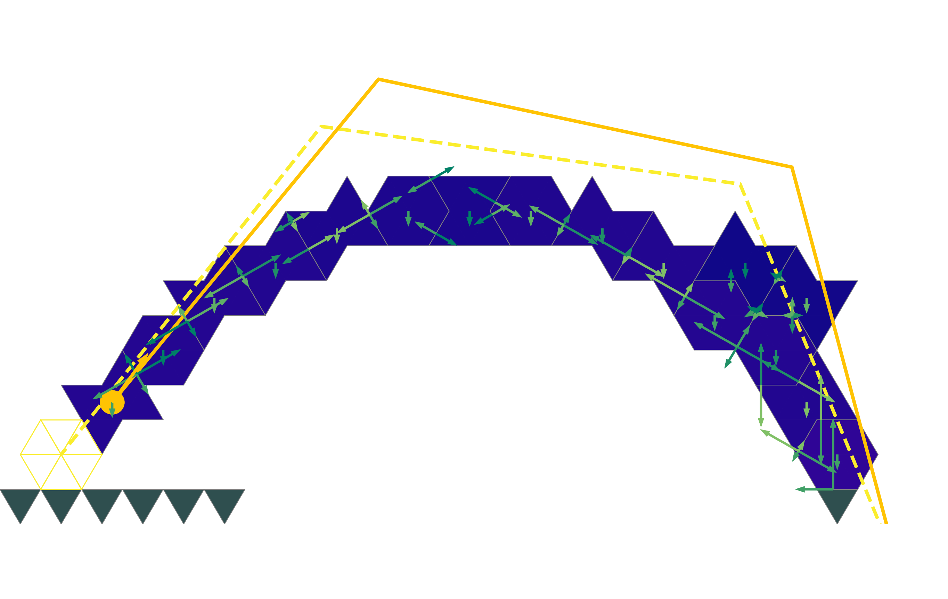
Multi-agent reinforcement learning
For construction of a spanning structure
Gabriel Vallat

Slide 2
What?
The construction of the spanning self-supporting structure

Slide 3
The project
Use a static simulator
Train agents to build a spanning self-supporting structure

Slide 4

Self-supporting structure
Uses gravity and friction
Only uses compressive forces
Unlike modern concrete structures, allows for the reuse of bricks

Slide 5
Self-supporting structure
Cross vault
Armadillo vault
Roman arch
Dome
Flying buttress
Automated construction

Slide 6
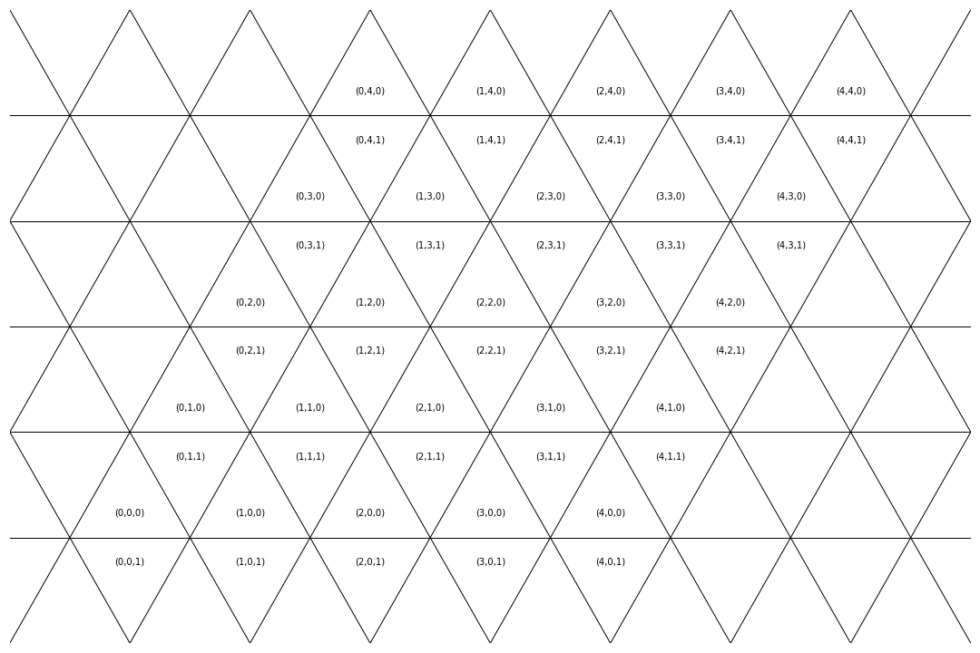
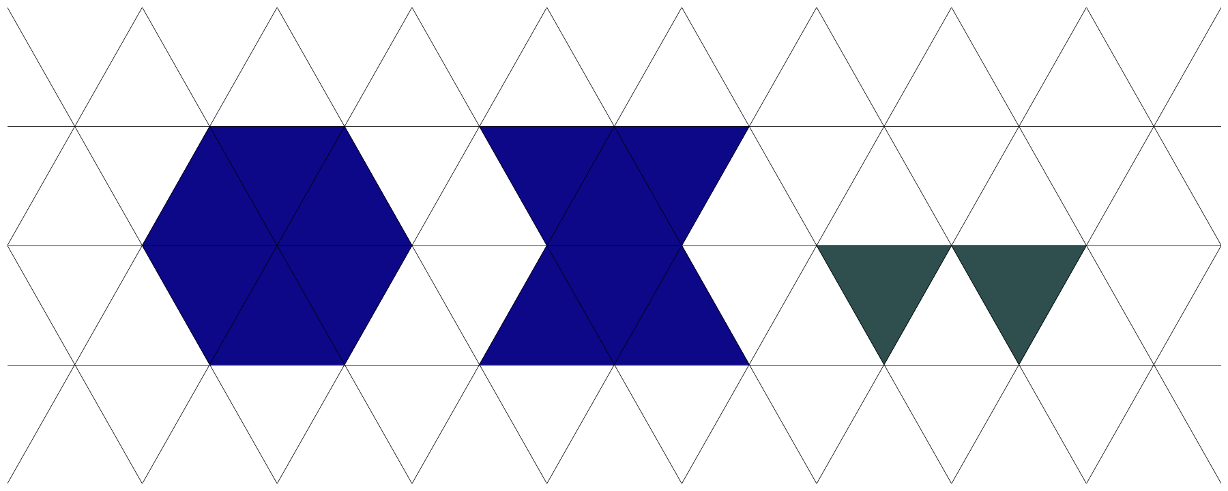
Setup
Discrete 2D setup
Isometric grid
2 types of blocks
Grounds of different length

Slide 7
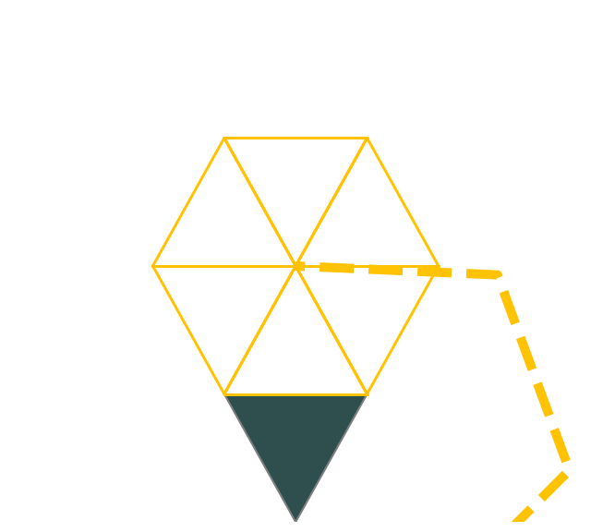

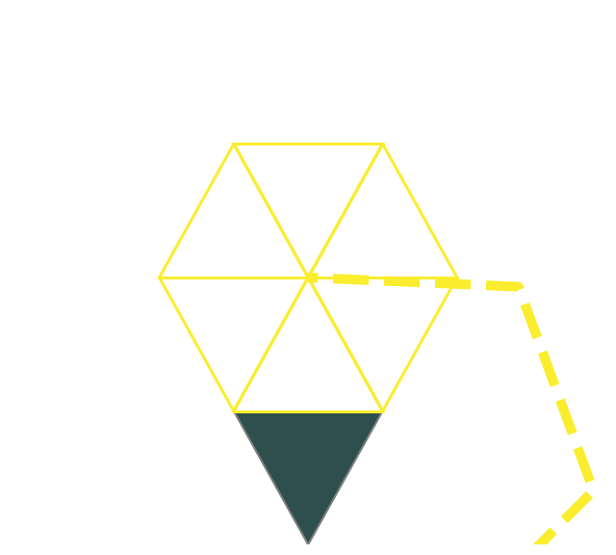

Setup
2 Robots that can
Hold an existing block
Place a new block

Slide 8
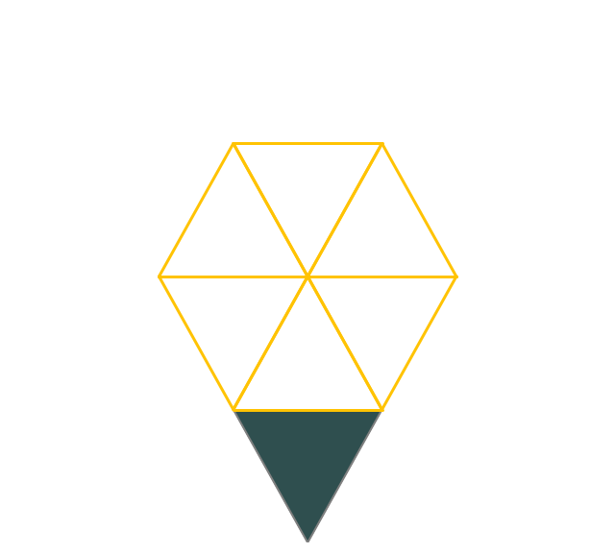

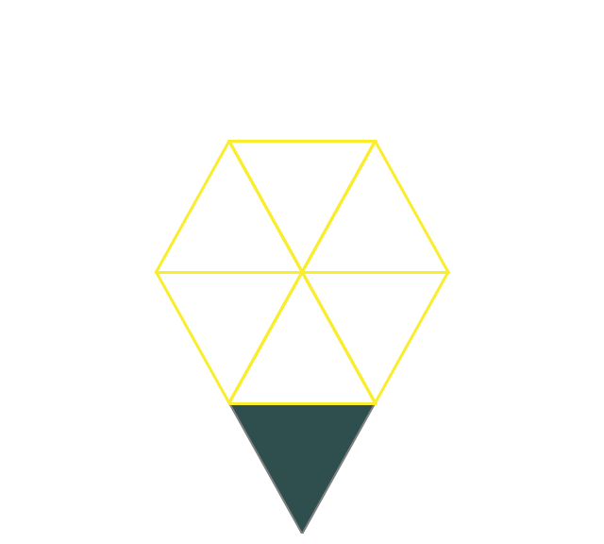

Setup
2 Robots that can
Hold an existing block
Place a new block

Slide 9
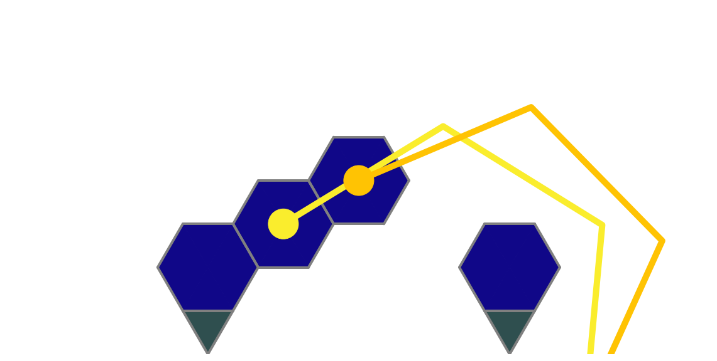
Task
Build a stable structure that connects two separate grounds

Slide 10
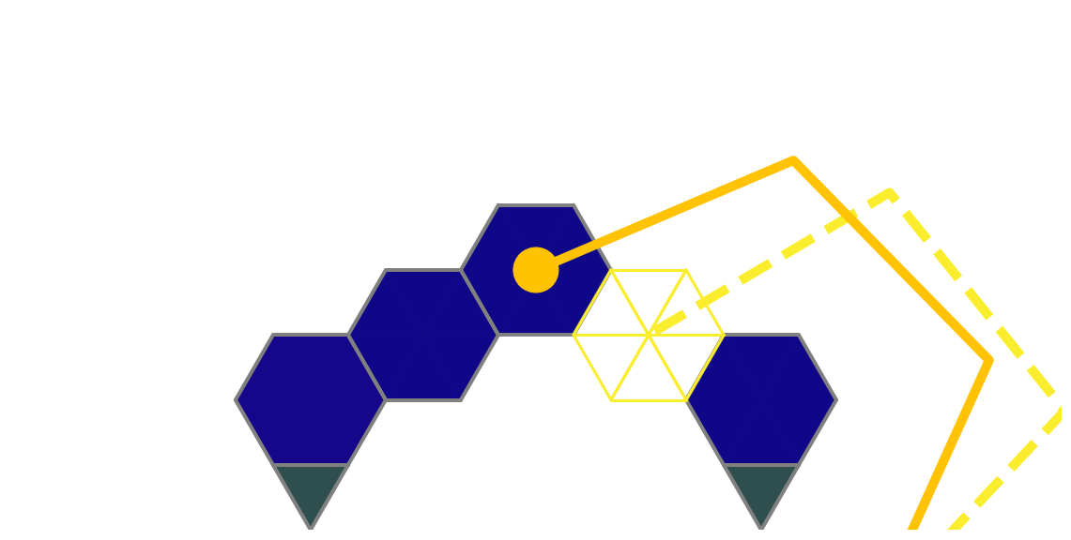
Task
Build a stable structure that connects two separate grounds

Slide 11
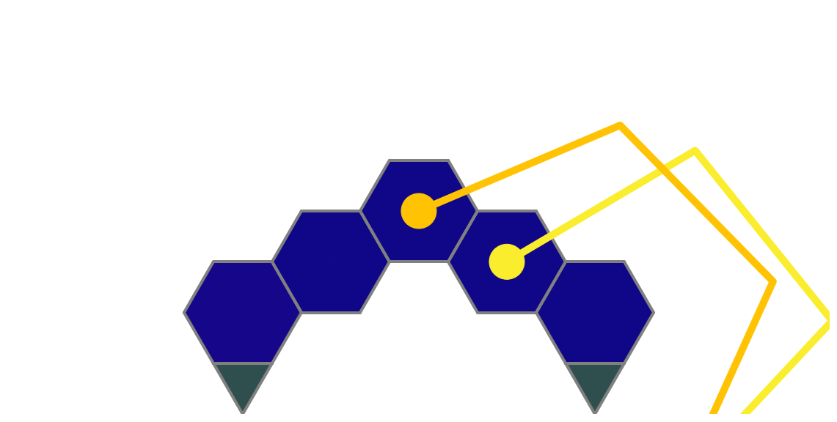
Task
Build a stable structure that connects two separate grounds

Slide 12
Task
Build a stable structure that connects two separate grounds

Slide 13
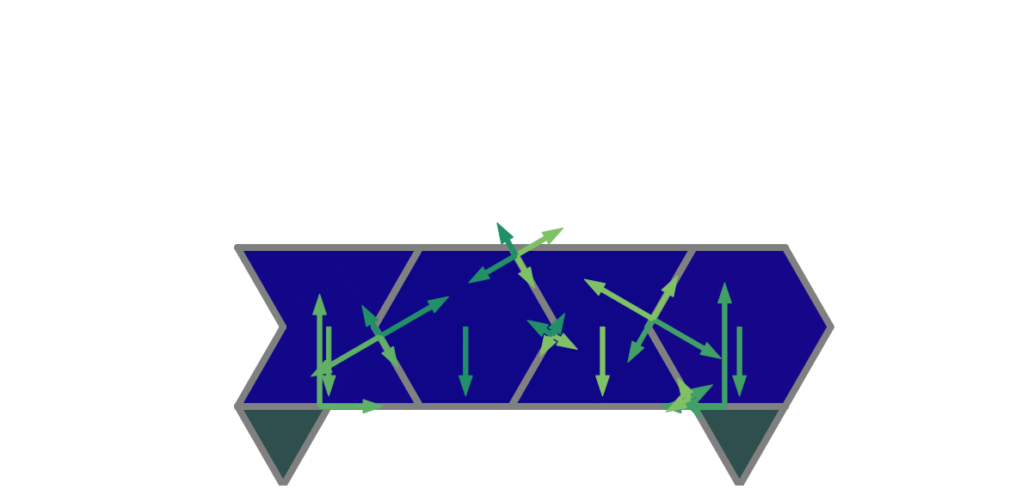
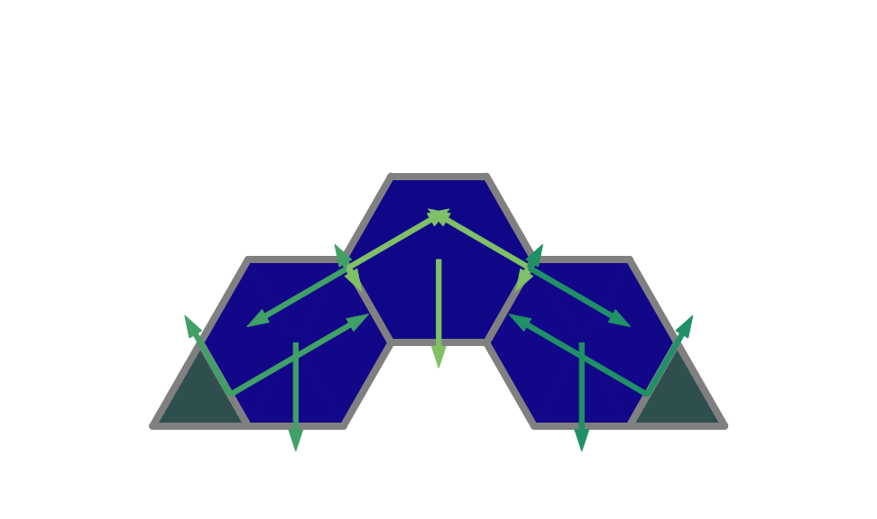
Physics
Check the stability of each blocks
Use a linear program formulation

Slide 14
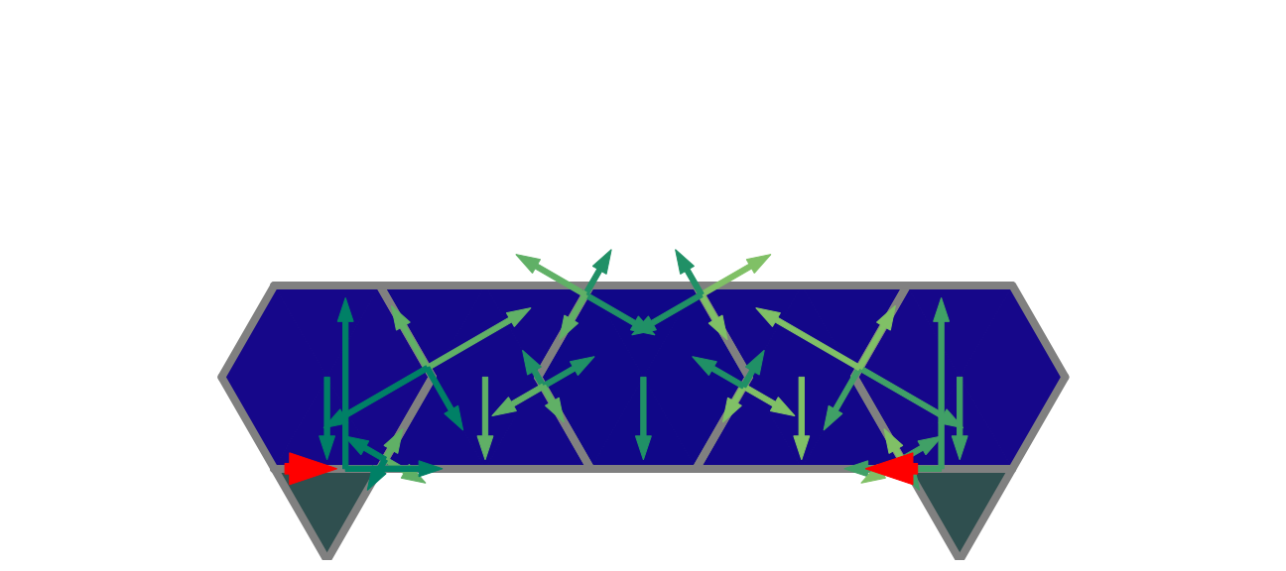
Physics
Constraints:
Newton’s first law
Compressive forces
Static friction

Slide 15
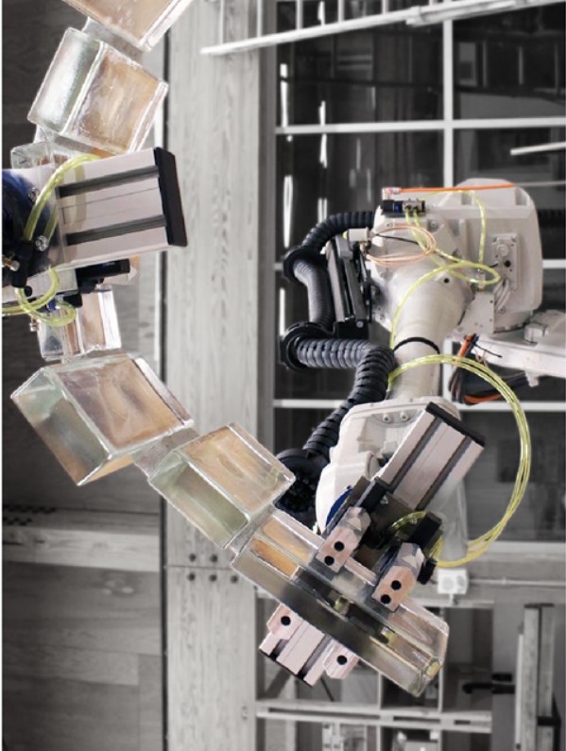
How
Multi-agent reinforcement learning

Slide 16
MARL
Several agents have to learn to cooperate to finish a task
What does learning mean?
Produce a good policy

Slide 17


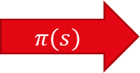
MARL
Several agents have to learn to cooperate to finish a task
What does learning mean?
Produce a good policy
$$π(s)$$

Slide 18
Exploration
How to chose an action?
Always pick the best one

Slide 19
Exploration
How to chose an action?
Pick the best one 90% of the time

Slide 20
Exploration
How to chose an action?
Pick the action proportionally to its value

Slide 21
Exploration
How to chose an action?
Pick the action proportionally to its value
Necessary to incentivise the entropy
No entropy

Slide 22
Exploration
How to chose an action?
Pick the action proportionally to its value
Necessary to incentivise the entropy
Maximum entropy

Slide 23
Exploration
How to chose an action?
Pick the action proportionally to its value
Necessary to incentivise the entropy
Intermediate entropy

Slide 24
MARL
Several agents have to learn to cooperate to finish a task
What does learning mean?
Produce a good policy

Slide 25
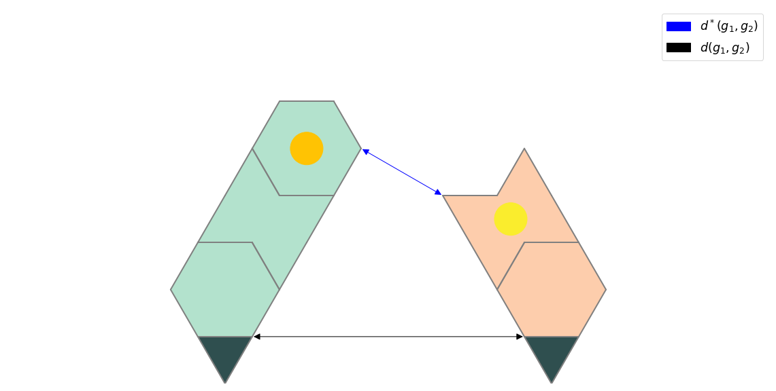
Rewards
Main rewards:
Collapse cost
Success reward
Helper rewards:
Smaller distance in free air between the grounds
More sides in contact
Less useless blocks placed

Slide 26
MARL
Several agents have to learn to cooperate to finish a task
What does learning mean?
Produce a good policy
How to learn?
By remembering mistakes that were done or good examples
By continuously trying to improve the current method

Slide 27
MARL
Several agents have to learn to cooperate to finish a task
What does learning mean?
Produce a good policy
How to learn?
By remembering mistakes that were done or good examples
By continuously trying to improve the current method

Slide 28
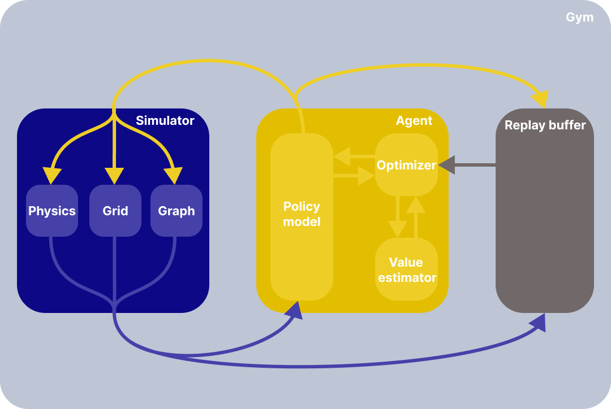
MARL
When using a single agent
Actor-critic architecture

Slide 29
How to learn?
Explore by using entropy
Soft actor-critic (SAC)
Learn by using surprise
Advantage actor-critic (A2C)

Slide 30
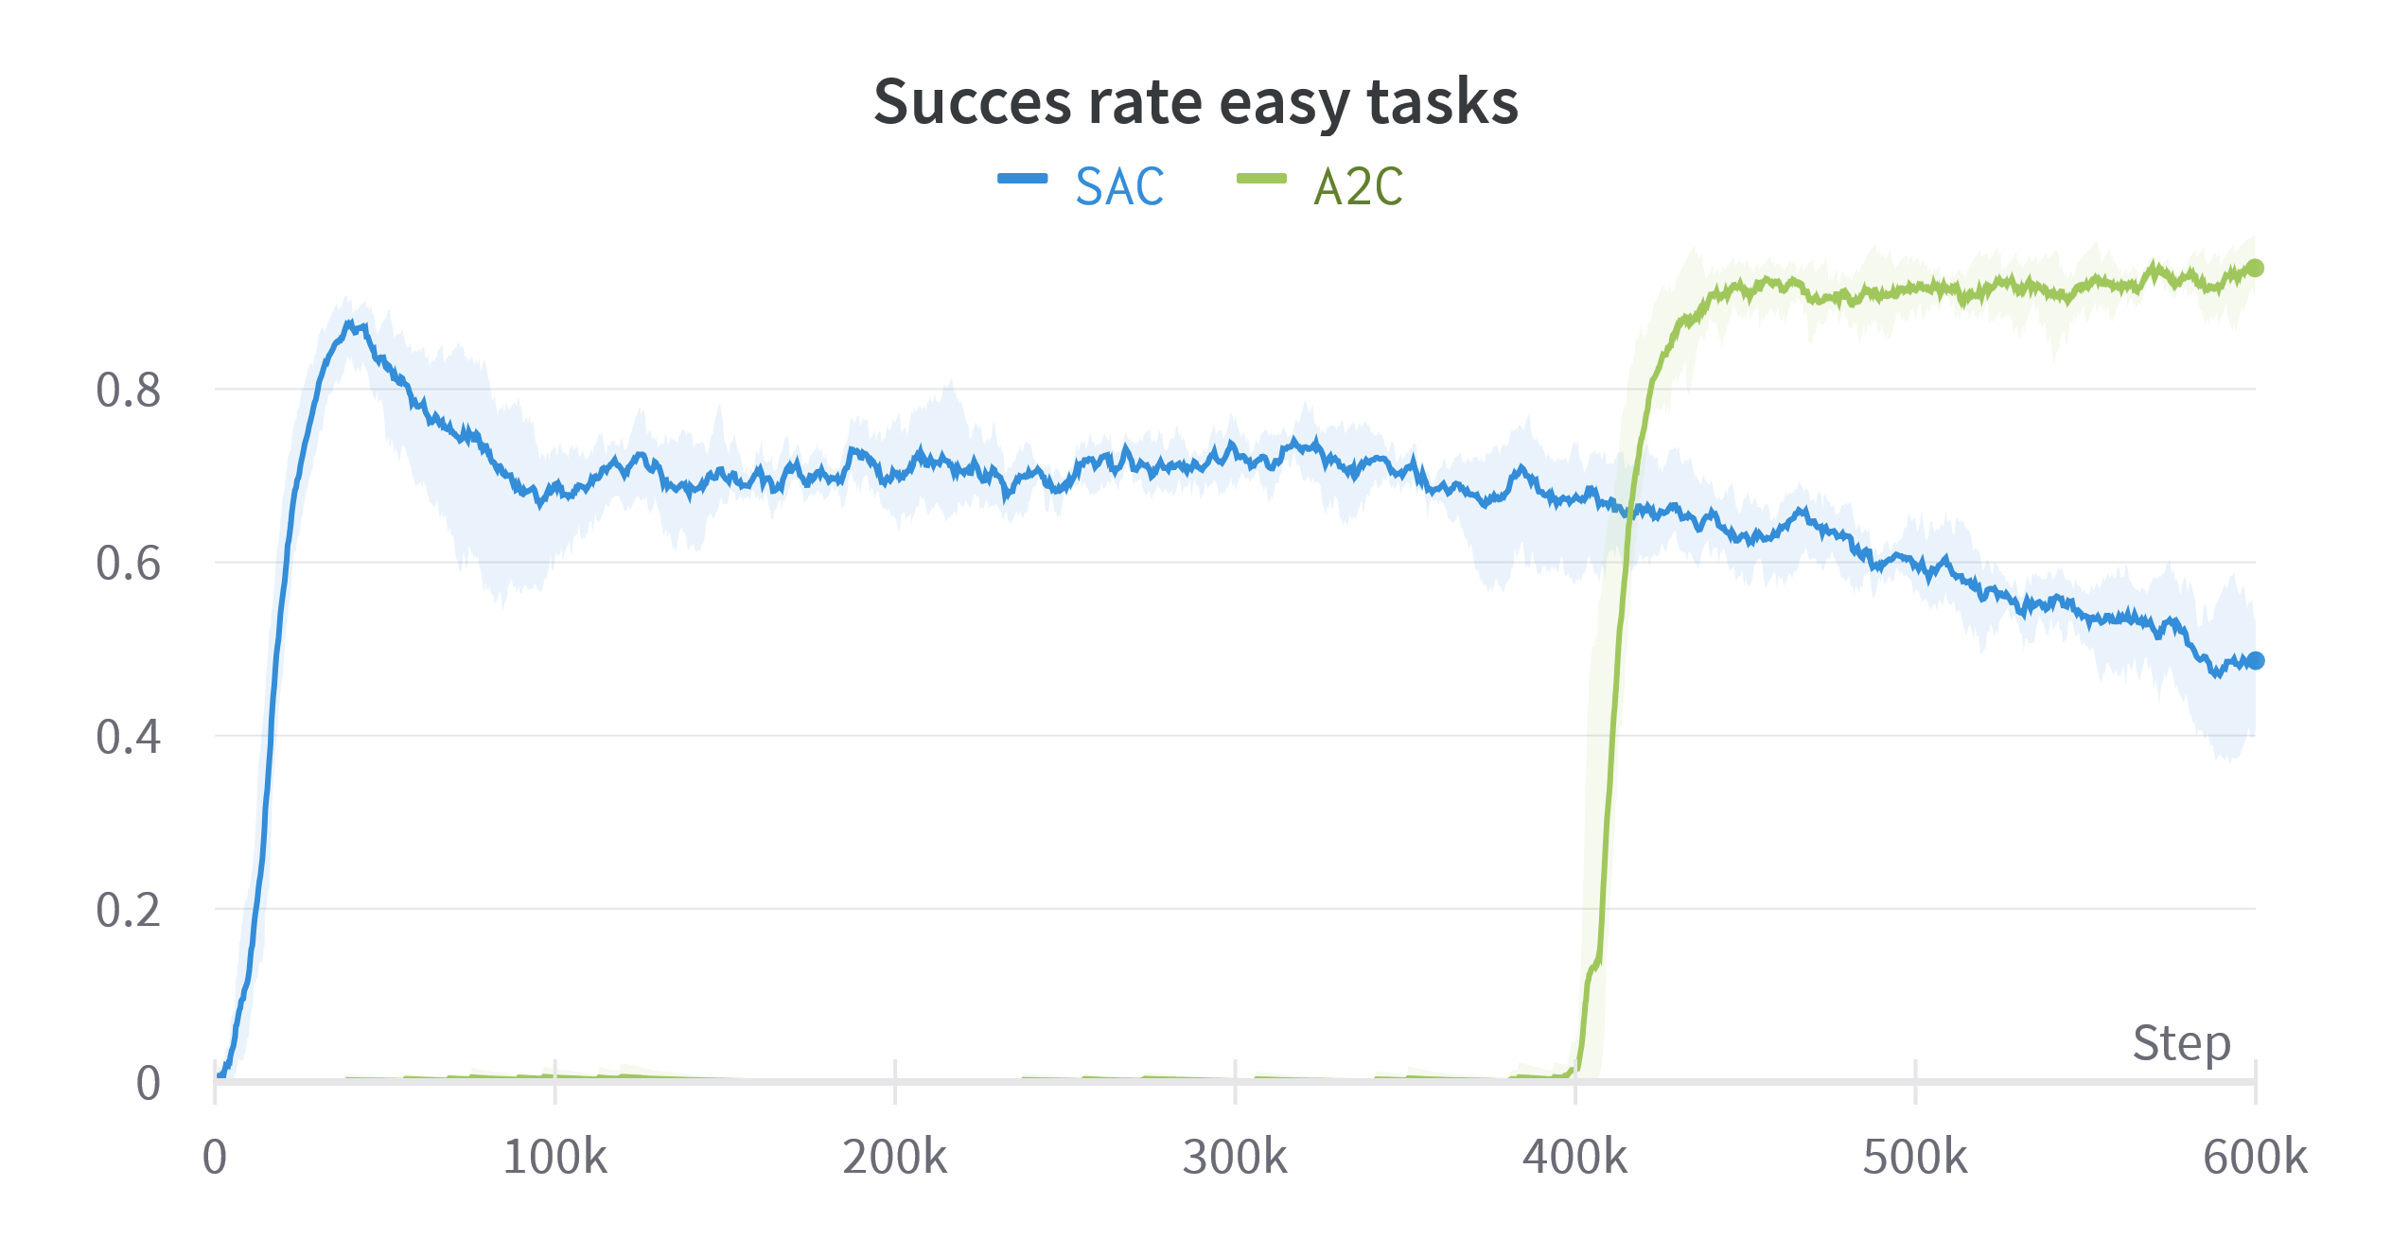
Exploration
2 algorithms
A2C
Uses ε-greedy policy
SAC
Uses softmax + entropy bonus

Slide 31
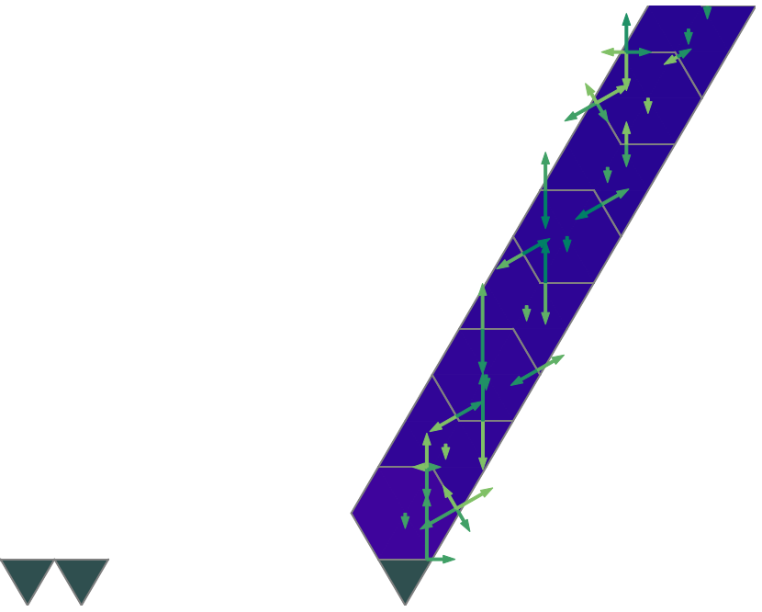
Exploration
2 algorithms
A2C
Uses ε-greedy policy
SAC
Uses softmax + entropy bonus

Slide 32
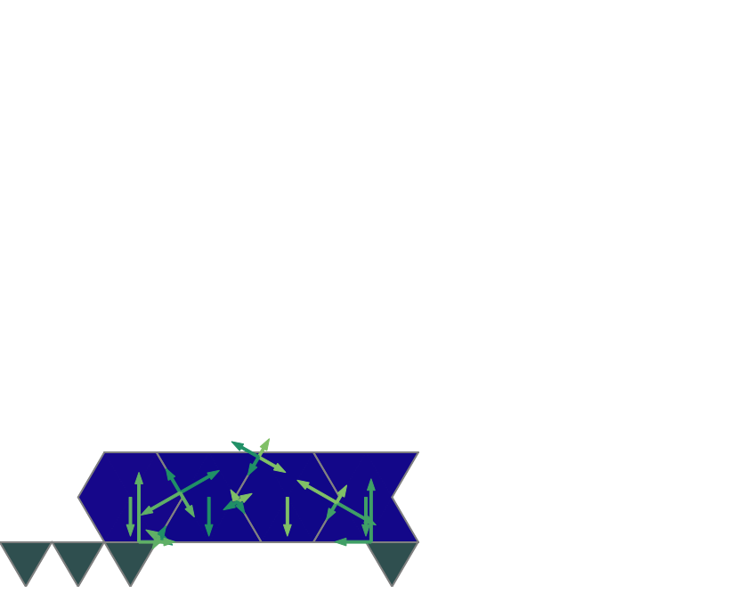
Exploration
2 algorithms
A2C
Uses ε-greedy policy
SAC
Uses softmax + entropy bonus

Slide 33
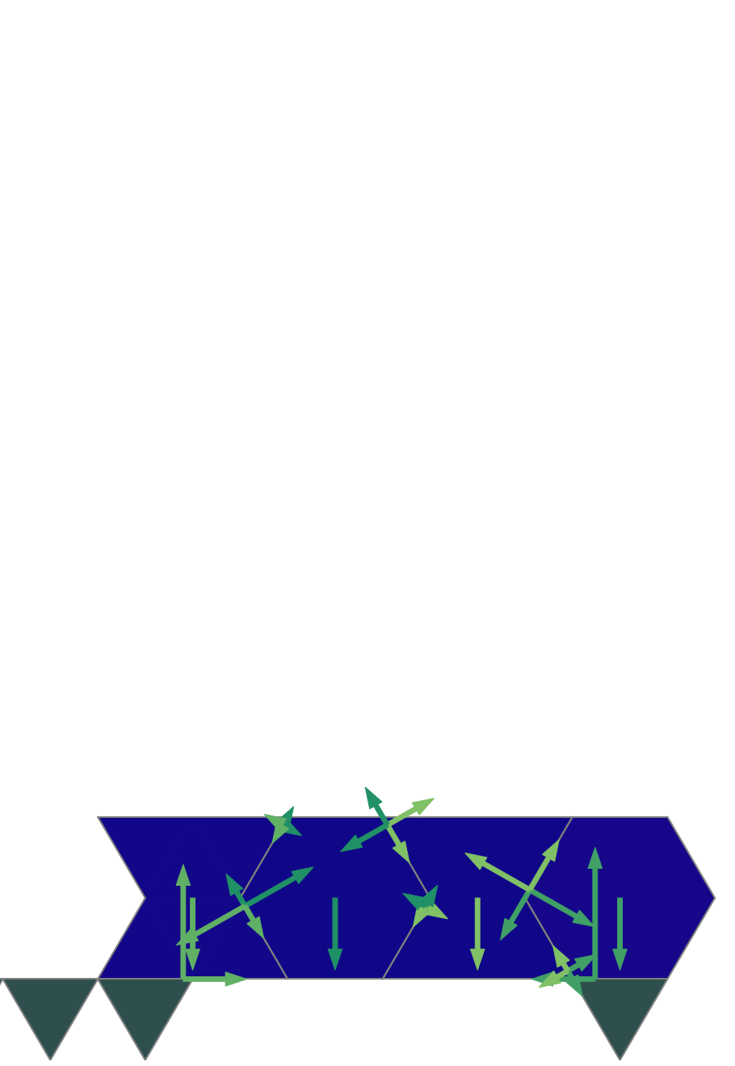
Exploration
2 algorithms
A2C
Uses ε-greedy policy
SAC
Uses softmax + entropy bonus

Slide 34
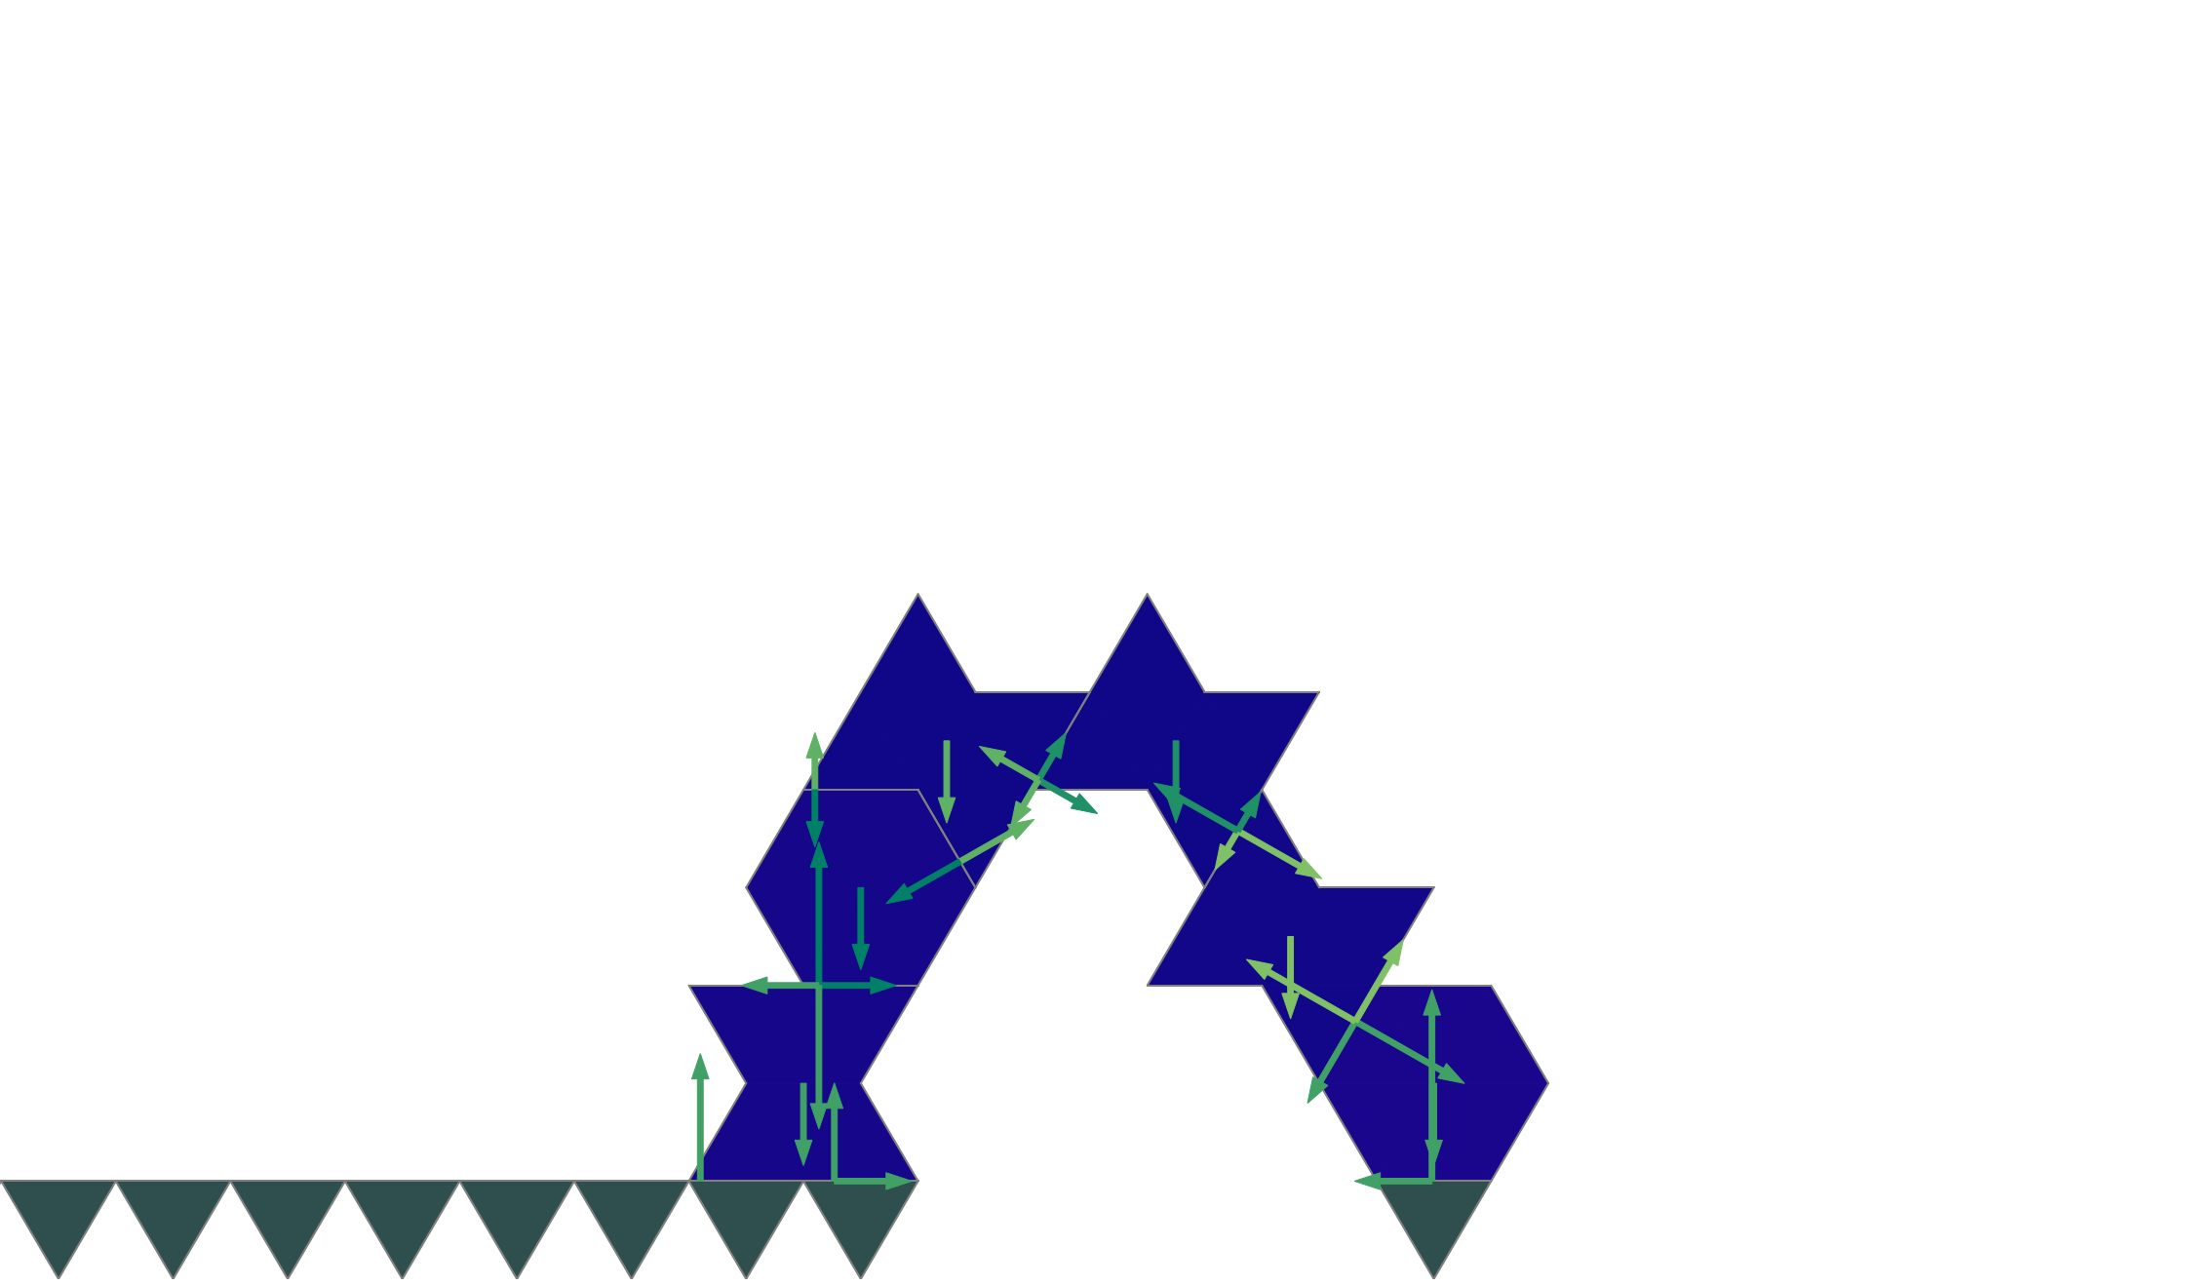
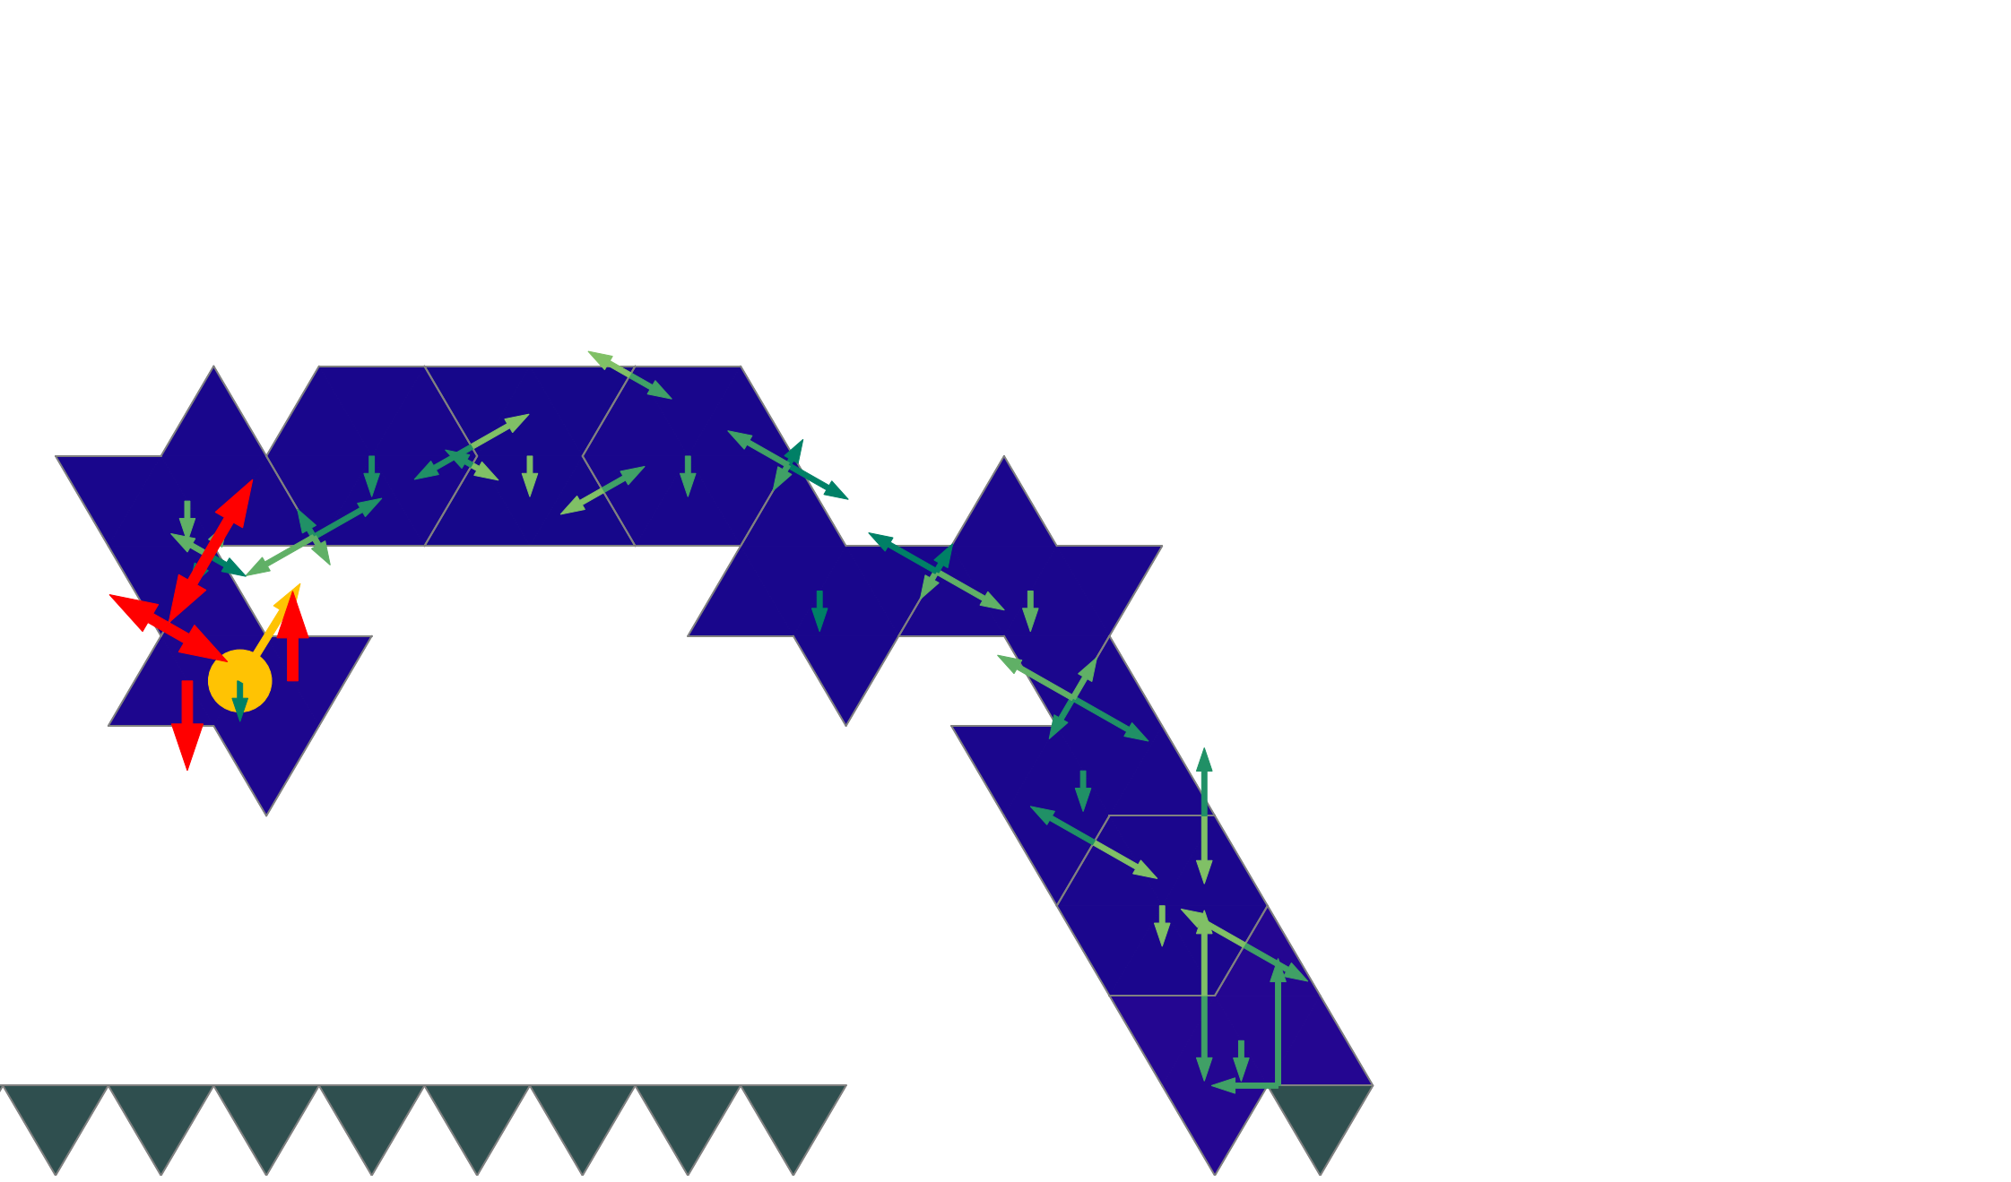
Exploration
2 algorithms
A2C
Uses ε-greedy policy
SAC
Uses softmax + entropy bonus

Slide 35
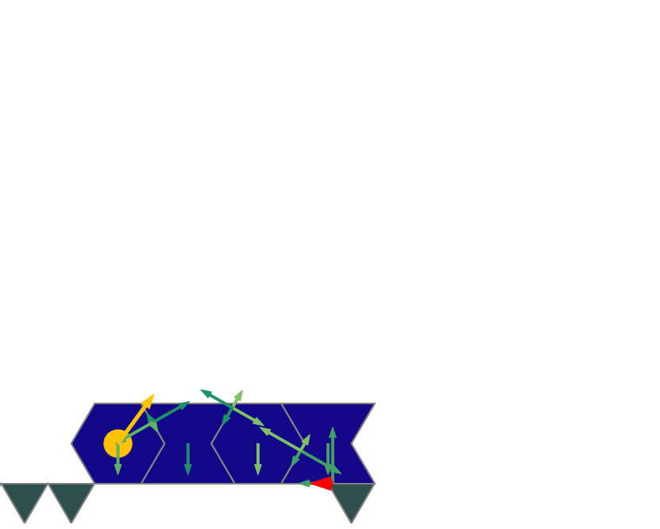
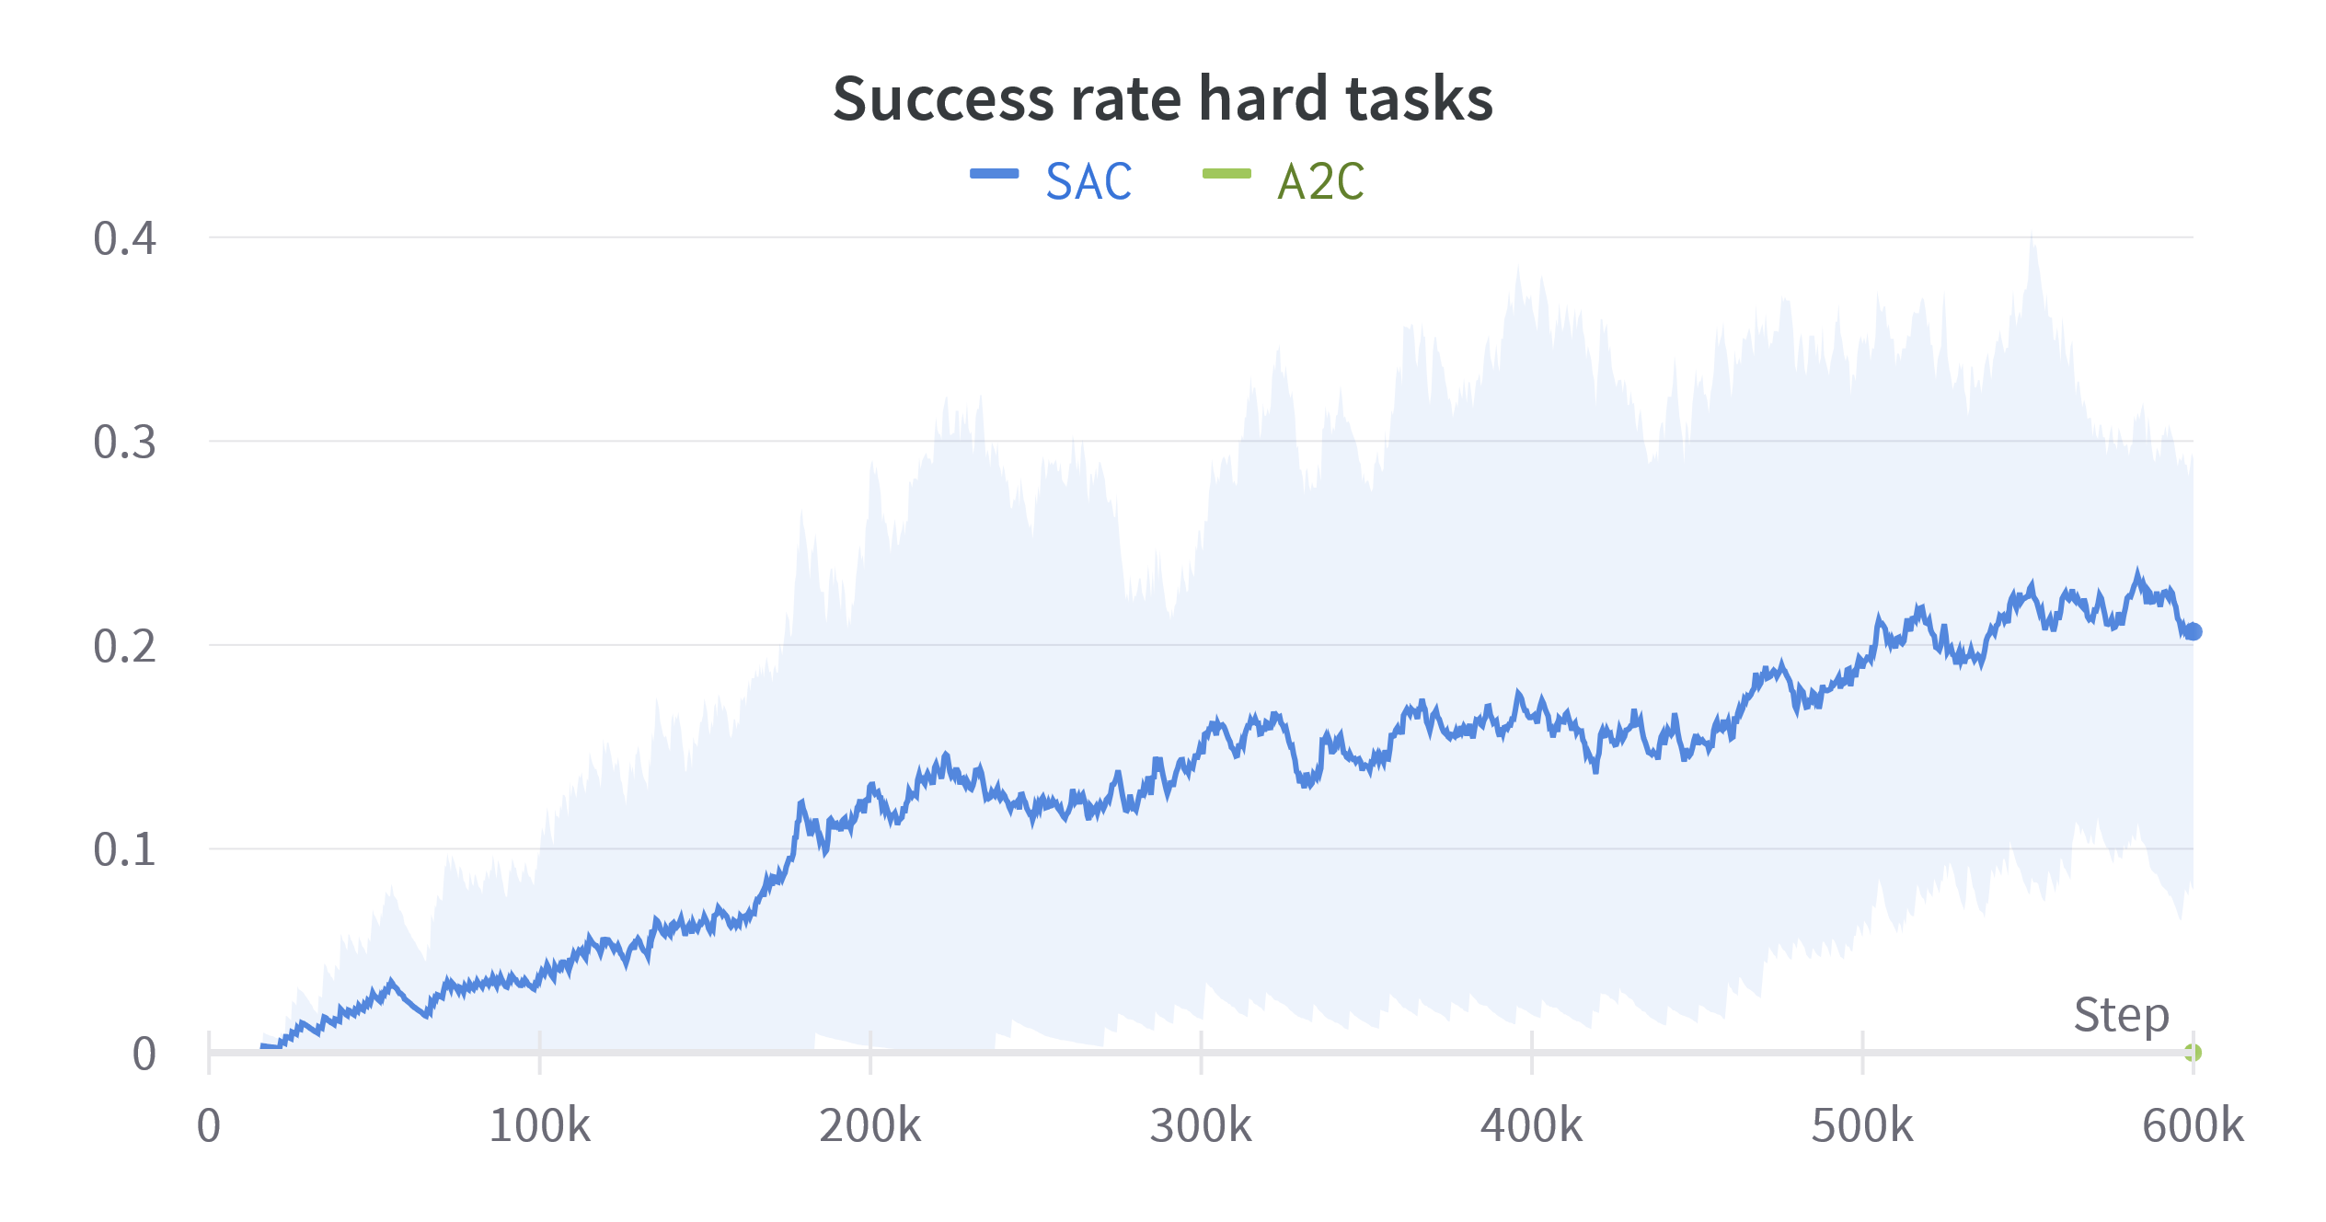
Exploration
2 algorithms
A2C
Uses ε-greedy policy
SAC
Uses softmax + entropy bonus

Slide 36
MARL
When using a single agent
Actor-critic architecture

Slide 37
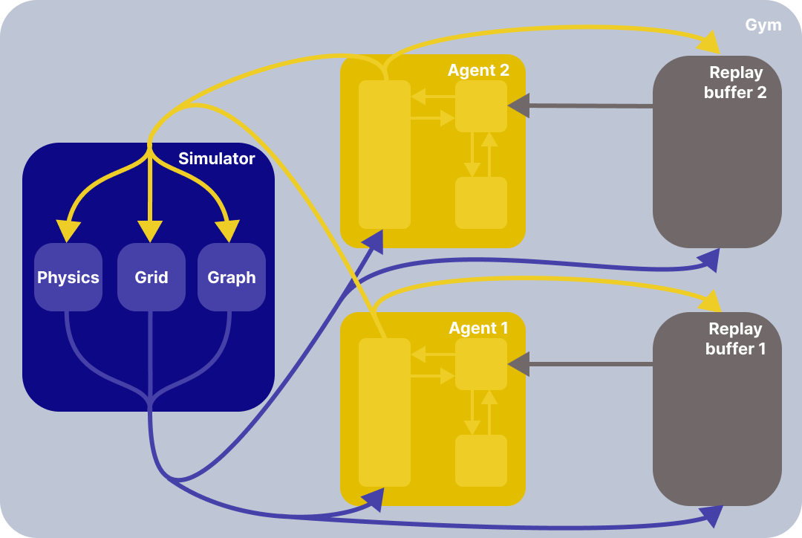
MARL
When using multiple agents
Distributed training

Slide 38
MARL
When using multiple agents
Centralized training:
A supervisor considers all agents at the same time, producing all of their actions.
Only the supervisor is learning
Single agent
Multi-agent
Centralized training

Slide 39
Centralized vs distributed
Task:
Bridge the gap
Gap width1
Gap width 2
Gap width 3
Gap width 5

Slide 40
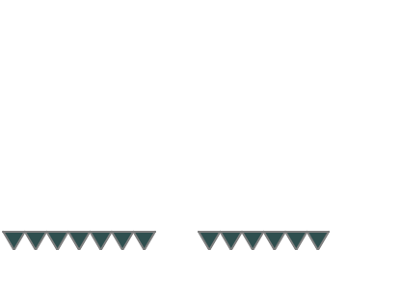
Centralized vs distributed
Task:
Bridge the gap
Distributed agents:
Act simultaneously
Can either wait or place a new block

Slide 41
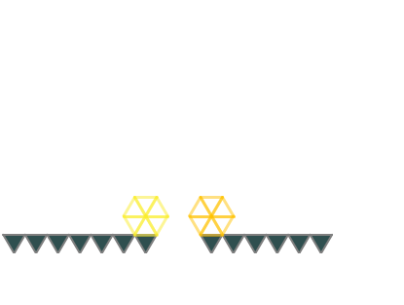
Centralized vs distributed
Task:
Bridge the gap
Distributed agents:
Act simultaneously
Can either wait or place a new block

Slide 42
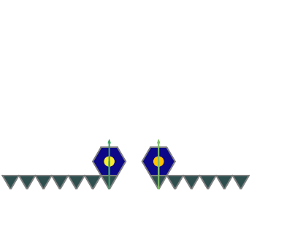
Centralized vs distributed
Task:
Bridge the gap
Distributed agents:
Act simultaneously
Can either wait or place a new block

Slide 43
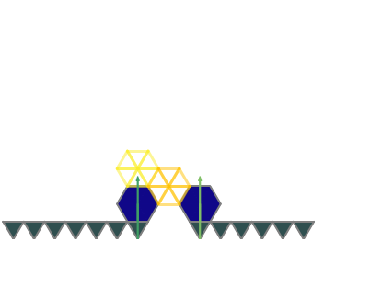
Centralized vs distributed
Task:
Bridge the gap
Distributed agents:
Act simultaneously
Can either wait or place a new block

Slide 44
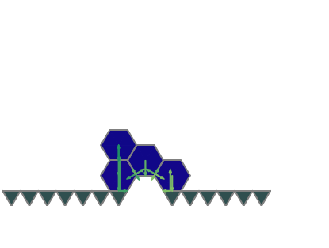
Centralized vs distributed
Task:
Bridge the gap
Distributed agents:
Act simultaneously
Can either wait or place a new block

Slide 45
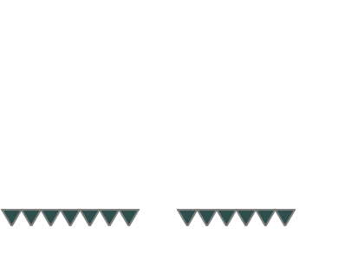
Centralized vs distributed
Task:
Bridge the gap
Distributed agents:
Act simultaneously
Can either wait or place a new block
Centralized agent:
Act sequentially
Must always place a new block

Slide 46
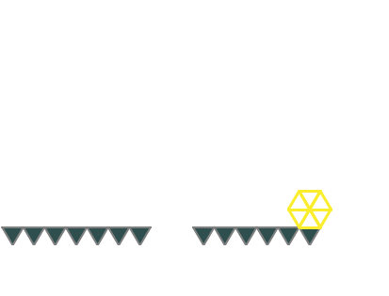
Centralized vs distributed
Task:
Bridge the gap
Distributed agents:
Act simultaneously
Can either wait or place a new block
Centralized agent:
Act sequentially
Must always place a new block

Slide 47
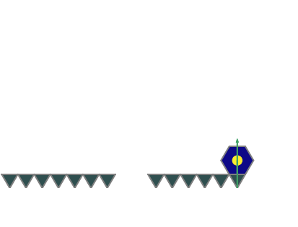
Centralized vs distributed
Task:
Bridge the gap
Distributed agents:
Act simultaneously
Can either wait or place a new block
Centralized agent:
Act sequentially
Must always place a new block

Slide 48
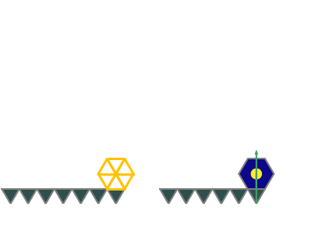
Centralized vs distributed
Task:
Bridge the gap
Distributed agents:
Act simultaneously
Can either wait or place a new block
Centralized agent:
Act sequentially
Must always place a new block

Slide 49
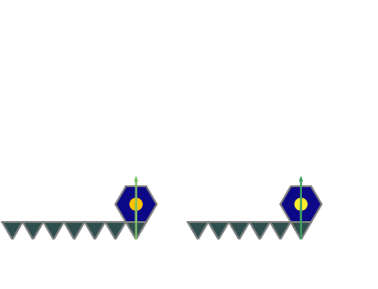
Centralized vs distributed
Task:
Bridge the gap
Distributed agents:
Act simultaneously
Can either wait or place a new block
Centralized agent:
Act sequentially
Must always place a new block

Slide 50
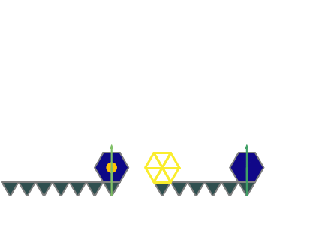
Centralized vs distributed
Task:
Bridge the gap
Distributed agents:
Act simultaneously
Can either wait or place a new block
Centralized agent:
Act sequentially
Must always place a new block

Slide 51
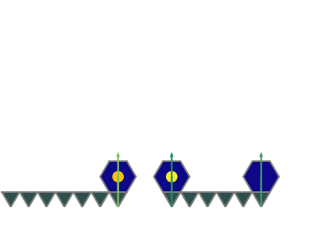
Centralized vs distributed
Task:
Bridge the gap
Distributed agents:
Act simultaneously
Can either wait or place a new block
Centralized agent:
Act sequentially
Must always place a new block

Slide 52
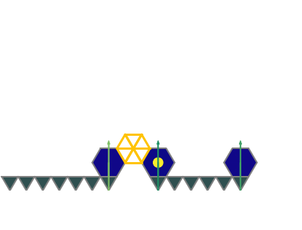
Centralized vs distributed
Task:
Bridge the gap
Distributed agents:
Act simultaneously
Can either wait or place a new block
Centralized agent:
Act sequentially
Must always place a new block

Slide 53
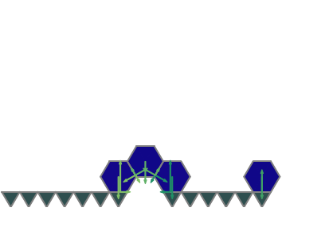
Centralized vs distributed
Task:
Bridge the gap
Distributed agents:
Act simultaneously
Can either wait or place a new block
Centralized agent:
Act sequentially
Must always place a new block

Slide 54
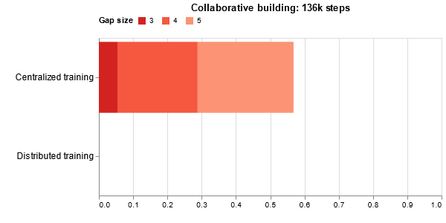
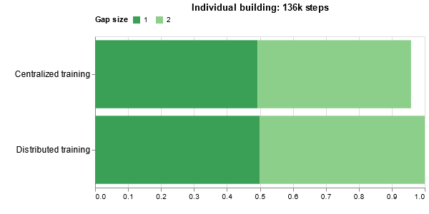
Results

Slide 55
Results
Add pictures
Talk about
The distributed algo learns not to collide
The centralized algo has more facility to collaborate

Slide 56
Conclusion

Slide 57
Success
Building large spanning structures

Slide 58
Challenges
Building a spanning structure is vague
Formal task description
Reward design
What is a failure?
MARL takes time
Often takes more than a day to train a single agent
Lots of unpredicted local minima
Only state of the art method achieves a good performance

Slide 59
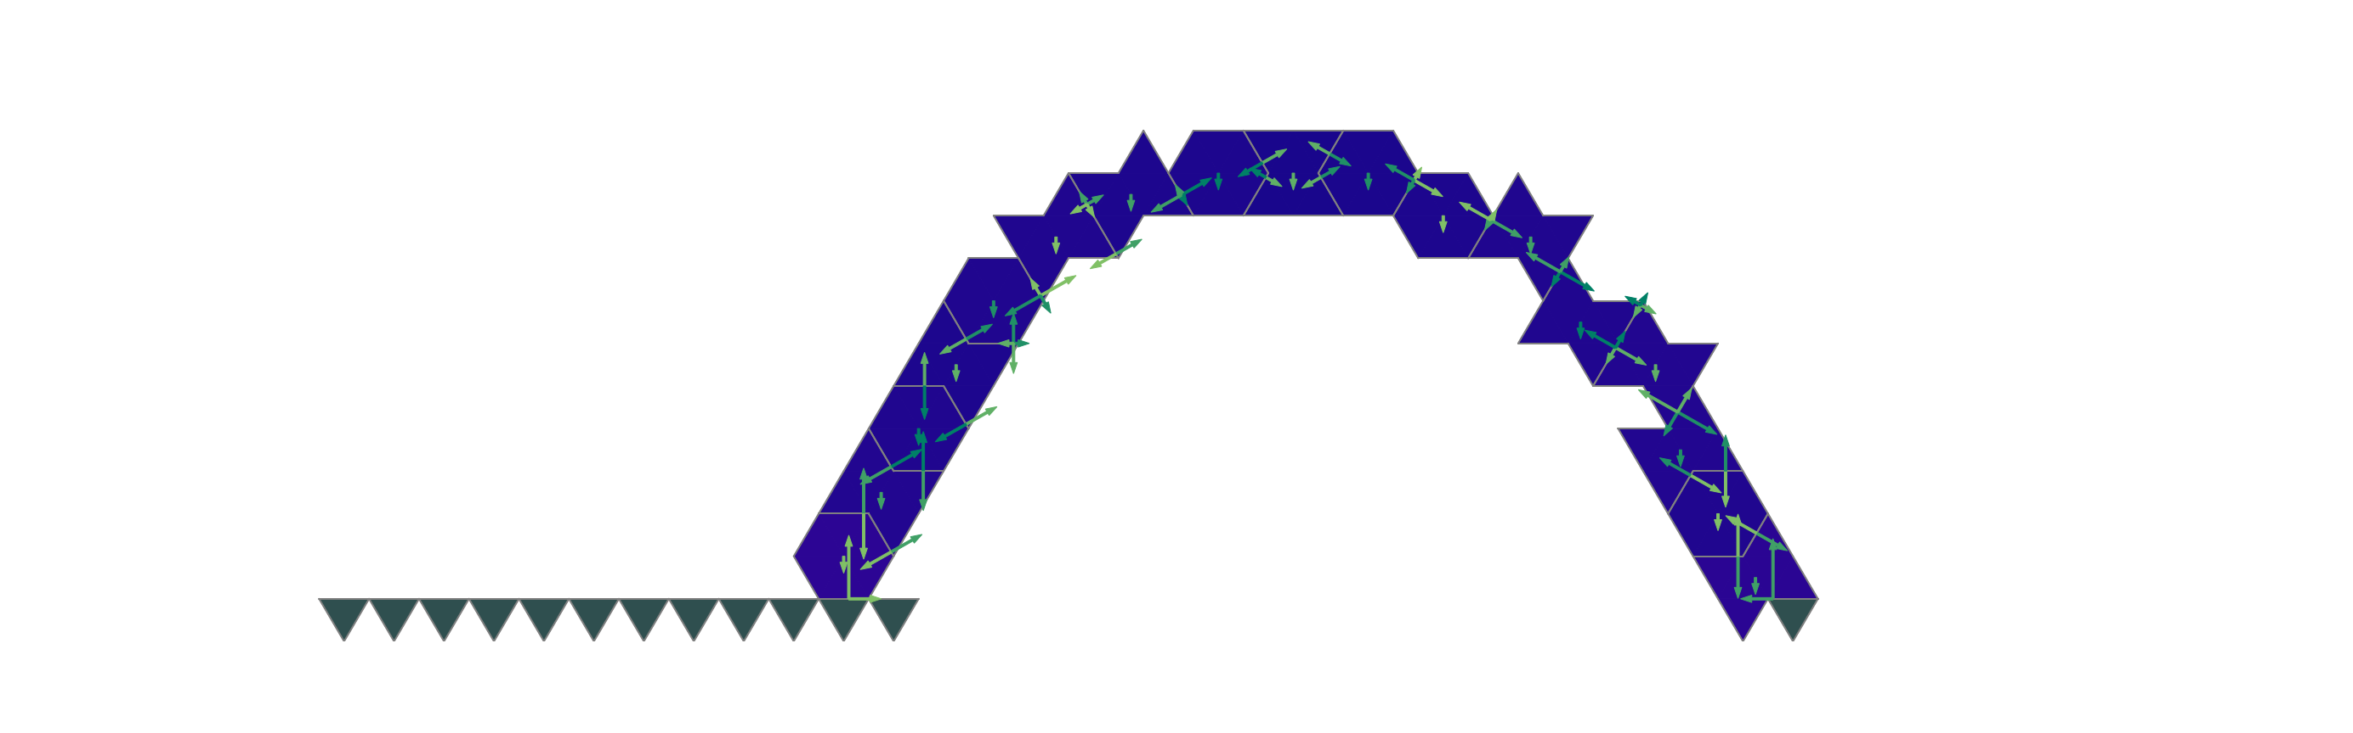
Take aways
Fully distributed training works poorly on tasks that requires a tight coordination
Centralized training is better for this task
SAC searches efficiently the best policy
SAC allows to modify the structure midway
Good starting point to bridge the simulation to real world gap

Slide 60
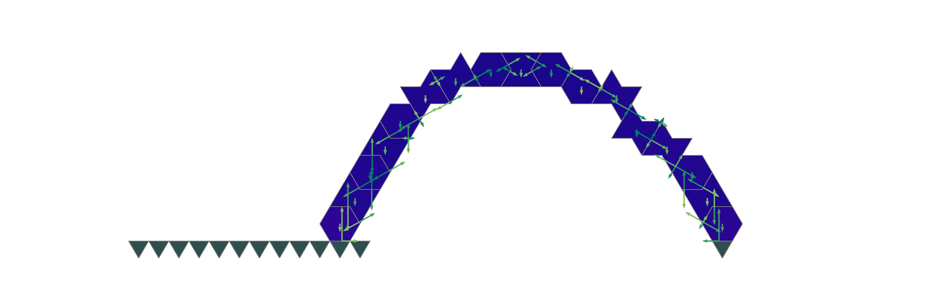
Take aways
Fully distributed training works poorly on tasks that requires a tight coordination
Centralized training is better for this task
SAC searches efficiently the best policy
SAC allows to modify the structure midway
Good starting point to bridge the simulation to real world gap

Slide 61
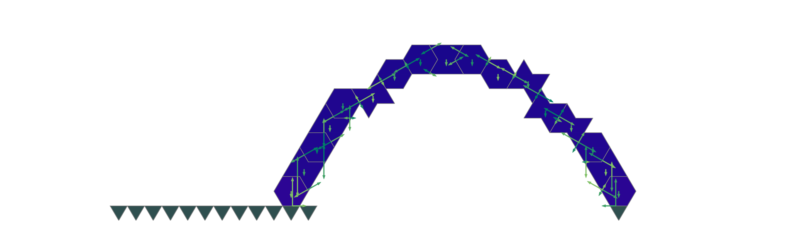
Take aways
Fully distributed training works poorly on tasks that requires a tight coordination
Centralized training is better for this task
SAC searches efficiently the best policy
SAC allows to modify the structure midway
Good starting point to bridge the simulation to real world gap

Slide 62
Next steps
Toward a more real environment:
Continuous domain
Sensor feedback
Noise
Real environment
Toward more agents:
Setups between fully centralized and fully distributed
More game theoretical approaches
Toward other types of tasks:
Obstacles
Unique blocks

Slide 63
Thank you
Questions?

Slide 64
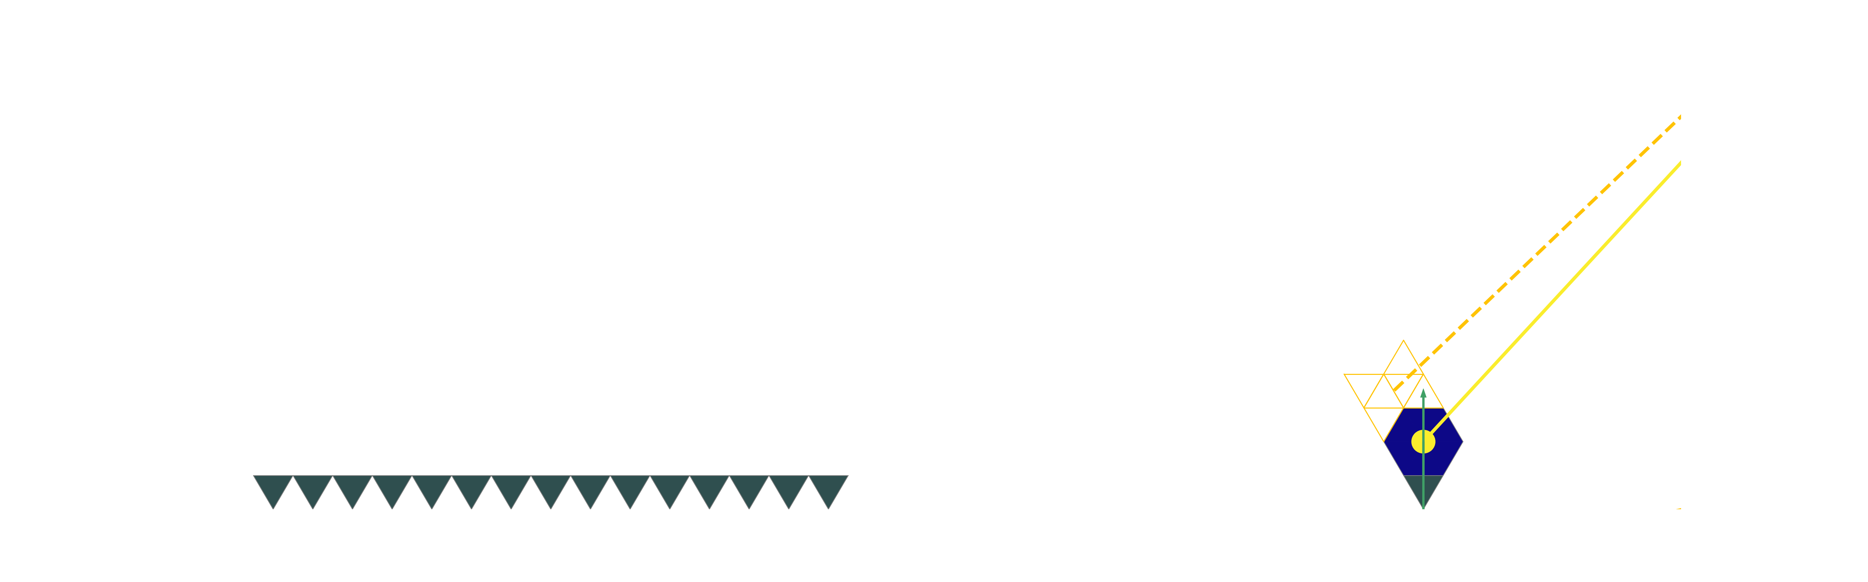
Off policy vs on policy

Slide 65
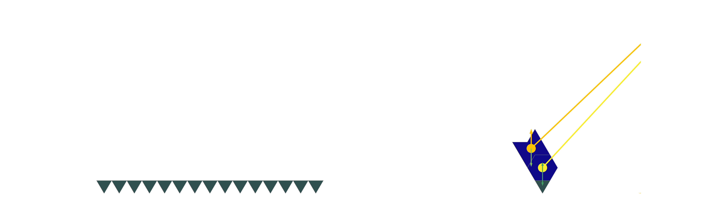
Off policy vs on policy

Slide 66
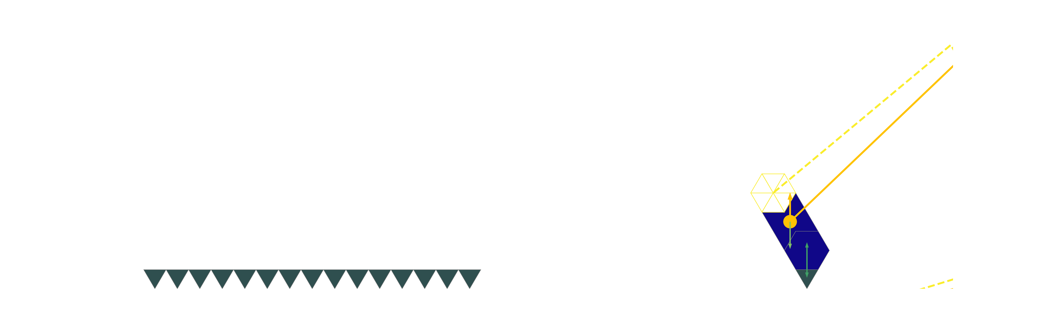
Off policy vs on policy

Slide 67
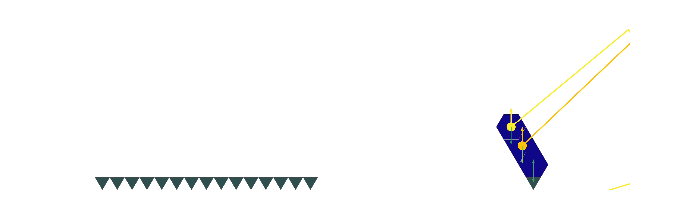
Off policy vs on policy

Slide 68
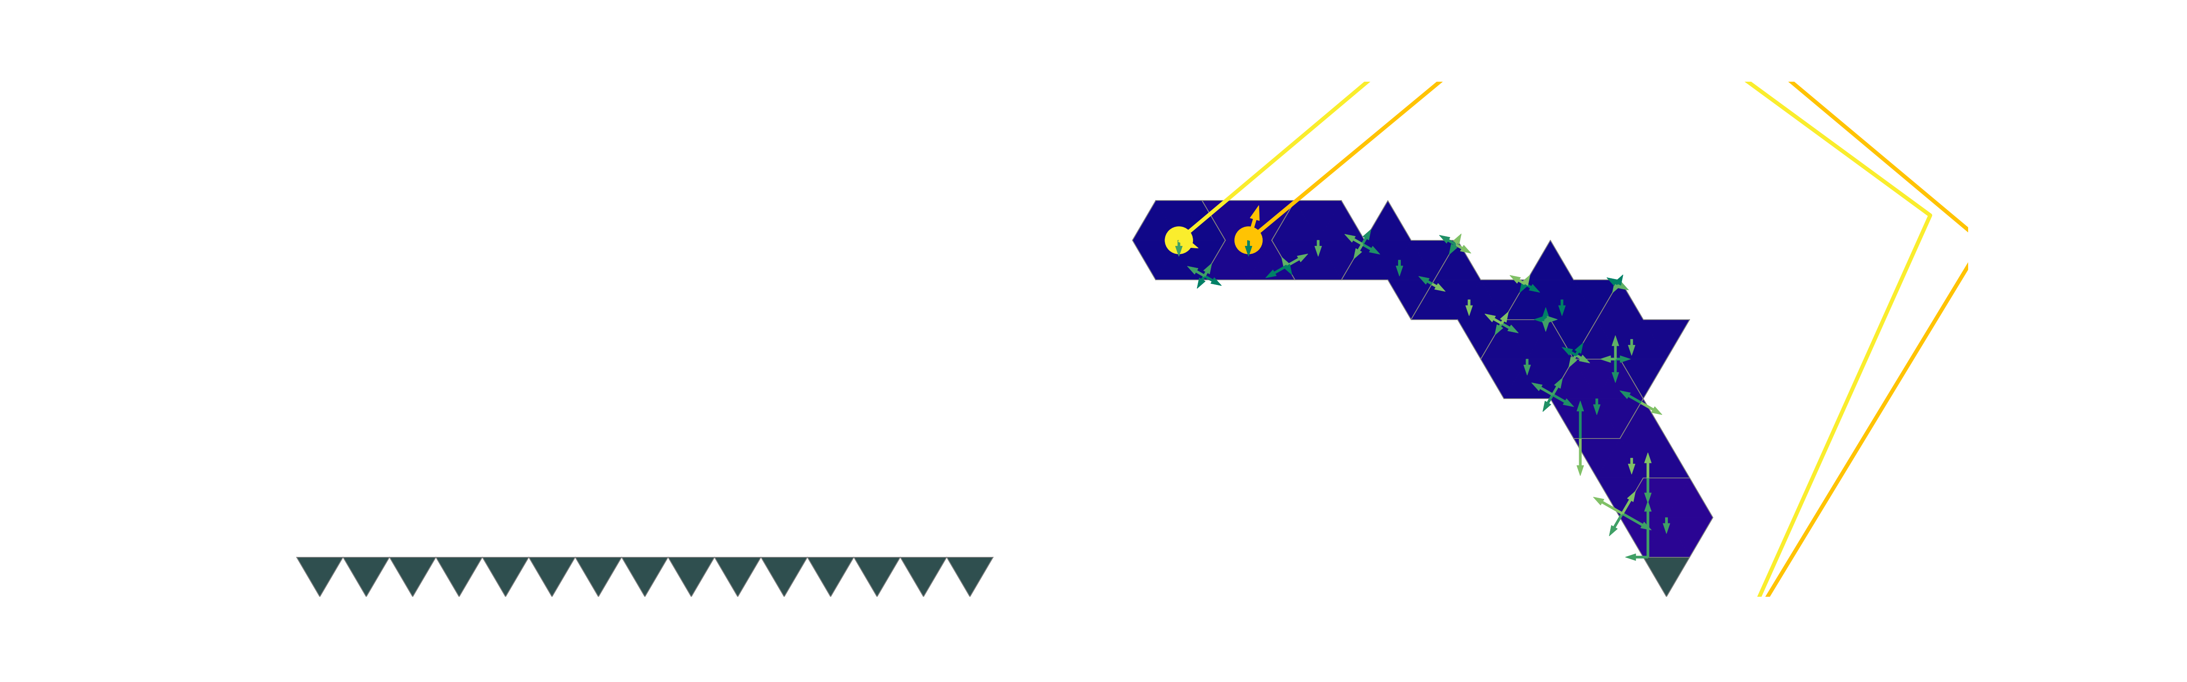
Off policy vs on policy

Slide 69

Off policy vs on policy

Slide 70

Off policy vs on policy

Slide 71
Off policy vs on policy

Slide 72
Off policy vs on policy

Slide 73

Entropy
$H\left(π(s)\right)=−\sum_{a}{π{\left(s\right)}_{a}\log\left(π{\left(s\right)}_{a}\right)=}E[−log⁡(π\left(s\right))]$
$\max\left(H\left(π\left(s\right)\right)\right)=−\log\left(\left|𝒜\right|\right)$
When $π\left(s\right)=𝒰(𝒜)$
$\min\left(H\left(π\left(s\right)\right)\right)=0$
When $π\left(s\right)=δ(a−a_{i})$ (deterministic policy)

Slide 74



Entropy bonus
$H\left(π\right)=−\sum_{s}{P\left(s\right)\sum_{a}{π{\left(s\right)}_{a}\log\left(π{\left(s\right)}_{a}\right)=}}E_{s,a}[−log⁡(π(s))]$
Modified reward:
$r^{′}\left(s,a\right)=r\left(s,a\right)+αH(π)$
Dynamic $α$:
Optimize alpha so that it grows when $H\left(π\right)<H_{t}$

Slide 75


Entropy bonus
$H\left(π\right)=−\sum_{s}{P\left(s\right)\sum_{a}{π{\left(s\right)}_{a}\log\left(π{\left(s\right)}_{a}\right)=}}E_{s,a}[−log⁡(π(s))]$
Modified reward:
$r^{′}\left(s,a\right)=r\left(s,a\right)+αH(π)$
Dynamic $α$:
Optimize alpha so that it grows when $H\left(π\right)<H_{t}$

Slide 76



Multi-agent

